Slide 1
Department of ECE
VLSI DESIGN
23EC2211A/R/E
Dr. Vijay Rao Kumbhare
Assistant Professor (ECE)
K L University, Hyderabad

Slide 2
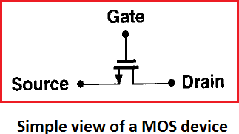
MOSFET as a Switch
Consider simple model of MOS device so to understand how transistor work as Switch
MOSFET shown in figure have three terminals: gate (G), source (S) and drain (D). The two termianl (Drain and Source) are interchangeable because device is symmetric.
Operating as Switch,
If V_{G} is ‘High’ → the transistor “connects” the source and the drain together
If V_{G} is ‘Low’ → the transistor isolates the source and the drain
Now even with this simplified view, some important question arises?
For what value of V_{G} does the device turn on? In other words, what is the “threshold” voltage?

Slide 3
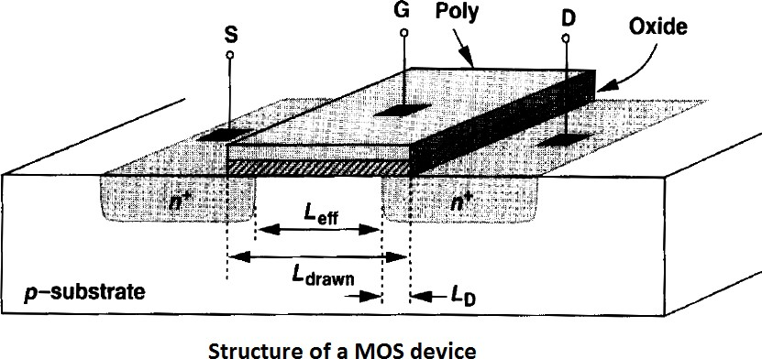
MOSFET Structure
N-type MOS is fabricated on p-type substrate also called the “bulk” or the “body”
Device consists two heavily-doped n regions forming source and drain
A heavily doped (conductive) piece of poly-silicon operating as Gate, and a thin layer of SiO₂ insulating gate from the substrate
MOS Dimensions
Length ‘L’: dimension of gate along source-drain path
Width ‘W’: dimension of gate perpendicular to length ‘L’
Above defined length ‘L’ is L_{drawn}, while during fabrication the S/D junction “side-diffuse”, therefore actual distance b/w S-D is slightly less than L_{drawn}
L_{eff} = L_{drawn} – 2L_{D} (where L_{eff} is effective length and L_{D} is amount of side diffusion)
Note: This L_{eff} and the gate oxide thickness ‘t_{ox}’ plays an important role in performance.

Slide 4
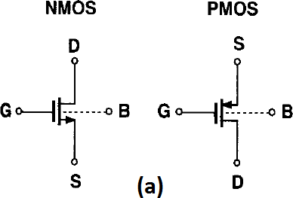
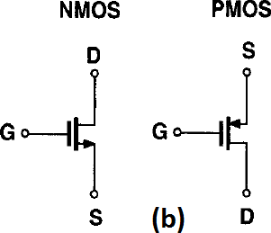
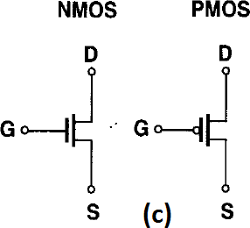
MOS Symbols
Fig (a), NMOS and PMOS symbol contains all four terminal. Substrate is denoted by “B” (bulk) rather than “S” to avoid confusion with source.
In PMOS, source is positioned on top as a visual aid because it has a higher potential than its gate.
Fig (b), NMOS and PMOS device bulk terminals are tied to ground and V_{DD} in most circuits.
Therefore bulk connections in drawing NMOS and PMOS symbols can be omitted.
Fig (c), This symbol of NMOS and PMOS depicted in fig (c) is used as “switch” in Digital circuits.

Slide 5
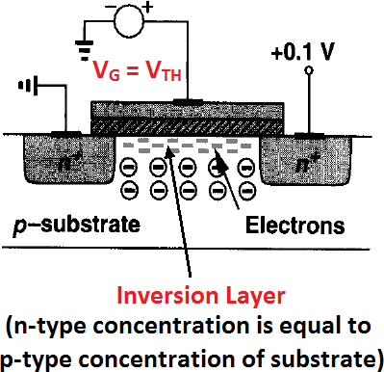
MOS I/V Characteristics
Analyze the generation and transport of charge in MOSFETs as a function of terminal voltages.
Derive equations for the MOS I/V characteristics such that the device physics can be abstracted to circuit level.
Threshold Voltage
The Threshold Voltage, also called Gate Voltage, commonly abbreviated as V_{TH} or V_{GS (TH)}, of a MOSFET is the minimum differential gate-to-source voltage that is needed to create a conducting path between the source and drain terminals.
It can be proved that:
^{Q}dep
φ_{MS} = Difference b/w the work functions of the
^{V}TH
= φ_{MS} + 2φ_{F} +
C
ox
polysilicon gate and the silicon substrate
⎛ kT ⎞
⎛ N ⎞
sub
φ = ⎜ ⎟ ⋅
l n
⎜
⎟
, C_{ox} is the gate oxide capacitance per unit area, Nsub is doping concentration in substrate
F
q
n
⎝ ⎠
⎝ i ⎠
^{Q}dep ⁼
2qε_{si} - 2φ_{F} N_{sub} =
4qε_{si} φ_{F} N_{sub} , Q_{dep} is the charge in the depletion region, and

Slide 6
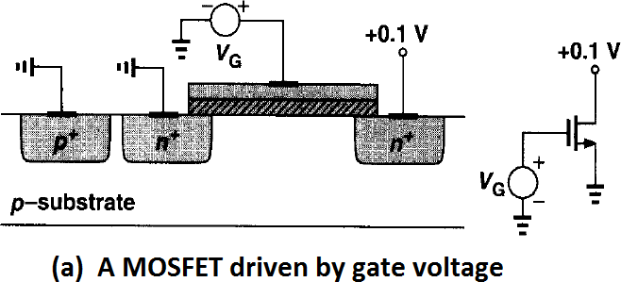
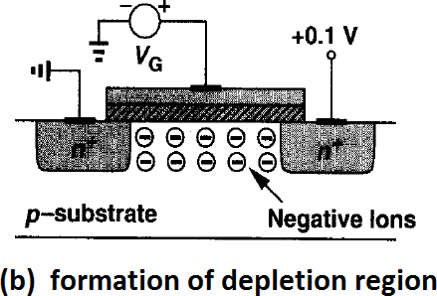
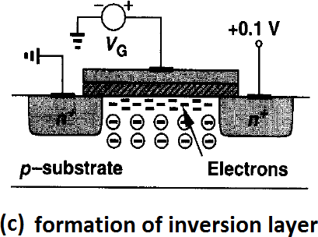
MOS I/V Characteristics
What happens as the Gate voltage V_{G} increases from zero?
V_{G} = 0, transistor is in OFF state
(b) V_{G} become positive (0 < V_{G} < V_{TH})
The holes in the p-substrate are repelled from the gate area, leaving negative ions behind so as to mirror the charge on the gate.
As V_{G} increase from 0 to V_{TH}
In other words, a depletion region is created.
No current flows because no charge carriers are available.
(c) V_{G} becomes more positive (V_{G} ≈ V_{TH})
Depletion region increases and at sufficiently positive gate voltage,
an inverted layer of the electrons (charge carrier) is formed under gate oxide between S and D and the transistor is “turned ON”.

Slide 7
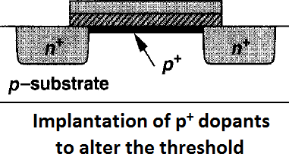
(d) V_{G} rises further (V_{G} > V_{TH}), the charge in depletion region remains relatively constant while the channel charge density continues to increase, providing a greater current from S to D.

Slide 8
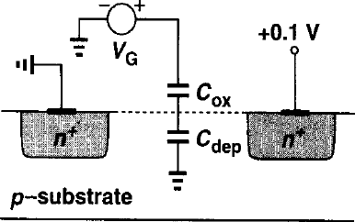
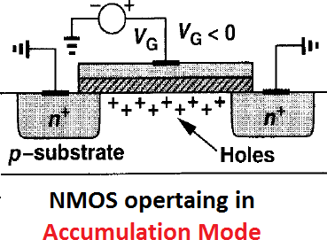
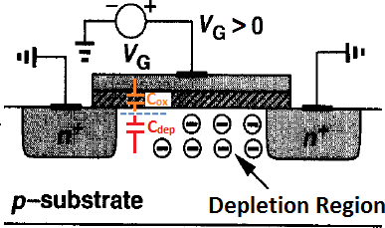
MOS Device as Capacitor
MOS structure resembles two capacitors in series:
The gate oxide capacitor
The depletion region capacitor
For NMOS
Source, Drain and Bulk of NFET are grounded and V_{G} vary from very negative value to very positive value. The two-terminal device can be viewed as a capacitor.
Gate oxide capacitance ‘C_{ox}’ will always be present while Depletion region capacitance
‘C_{dep}’ will change it’s value according to applied gate voltage.
1) When V_{G} < 0 → Accumulation Mode
Negative potential at gate attracts holes from substrate to the oxide interface.
Two-terminal device can be viewed as a capacitor having unit- area capacitance of C_{ox} separated by t_{ox}.
2) When 0 < V_{G} < V_{TH}
As V_{GS} rises, the density of holes at the interface falls
A depletion region begins to form under the oxide and the device will be in weak inversion

Slide 9
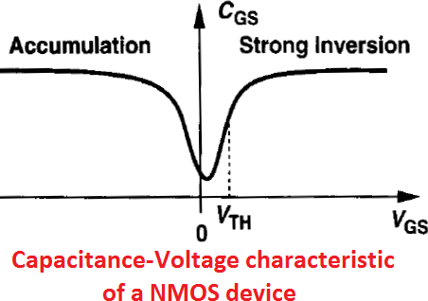
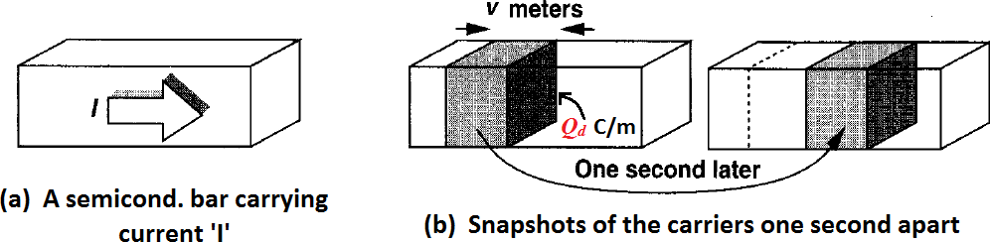
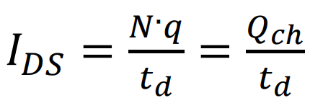
MOS Device as Capacitor
In this mode, the capacitance consists of the series combination of C_{ox} and C_{dep}. Therefore overall capacitance
(C_{ox} .C_{dep}/[C_{ox}+C_{dep}]) decreases.
3) When V_{G} ≥ V_{TH} → Inversion Mode
Finally as V_{GS} exceeds the V_{TH}, the oxide-silicon interface sustains a channel and the unit-area capacitance returns to C_{ox} (again increases to C_{ox}).
Derivation of I/V Characteristics
To find the relationship between the drain current of a MOSFET and its terminal voltages,
first understand these two observation give below:
1) Consider a semiconductor bar carrying a current I. If charge density along the direction of current is Q_{d} coulombs per meter and the velocity of the charge is ‘v’ meters per sec.
Then

Slide 10

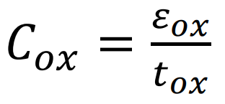
Derivation of I-V Characteristics
1. Channel Charge Density
From Q_{ch} = CV
C is the gate capacitance per unit length and V the voltage difference between the gate and the channel, then Q_{ch} is the desired charge density.
C = WC_{ox}
V = V_{GS} − V_{TH} because no mobile charge exists for V_{GS} < V_{TH}.
Q_{ch} = WCox(V_{GS} − V_{TH}).
Q_{ch} is expressed in coulomb/meter.
2. Drain Current at the linear, or triode, region.
Consider a bar of semiconductor having a uniform charge density (per unit length) equal to Q_{ch} and carrying a current I

Slide 11
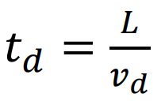
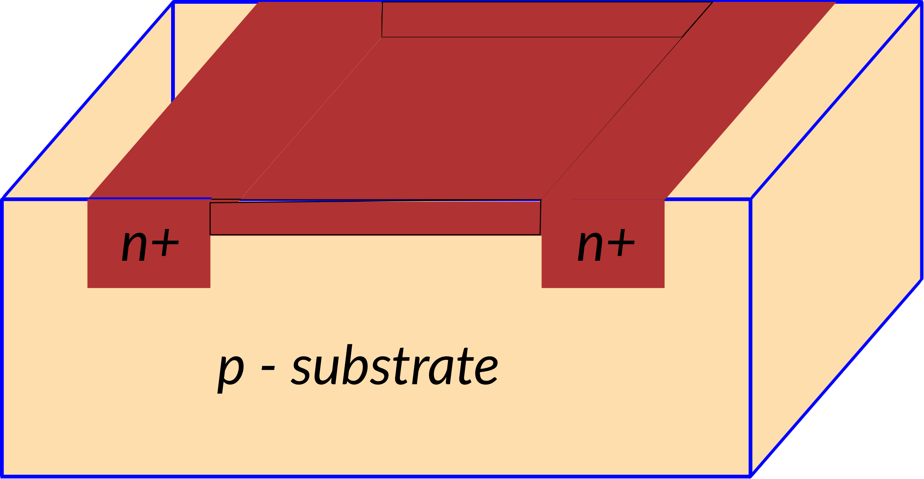

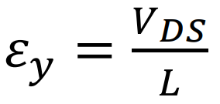
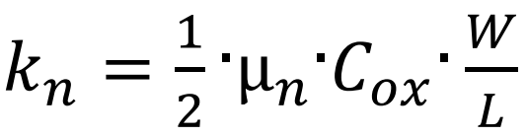
Derivation of I-V Characteristics
2. Drain Current at the linear, or triode, region. (as long as VDS kept in low level i.e VDS < VGS ‐ VTH)
Drift time, td, is directly proportional to the channel length L, and inversely proportional to the drift velocity of electrons, vd
Drift velocity, vd, is proportional to the horizontal electric field, εy, i.e.:
where µn is the electron mobility in the channel. The value of the horizontal electric field, εy, is, approximately, calculated as follows:
the following expression for IDS can be written as:
where kn is called conductivity factor for NMOS transistors. It is given by:

Slide 12
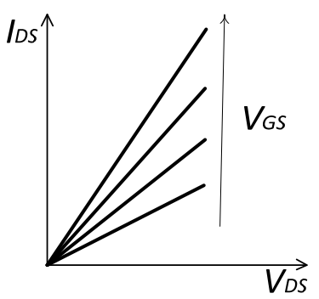
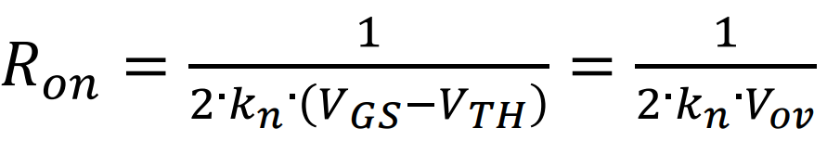
Derivation of I-V Characteristics
2. Drain Current at the linear, or triode, region. (as long as VDS kept in low level i.e VDS < VGS ‐ VTH)
(A)
The NMOS transistor operates in the linear, or triode, region, as long as VDS kept in low level i.e V_{DS} < V_{GS} ‐ V_{TH}
I_{DS} is proportional to V_{DS}.
Fig. 1 IDS ‐VDS curves of the NMOS transistor in linear region with VGS as parameter.
Practically, in linear region, the NMOS transistor acts like a variable resistance, Ron, whose value depends on Vov. Ron is calculated as follows:
(B)

Slide 13
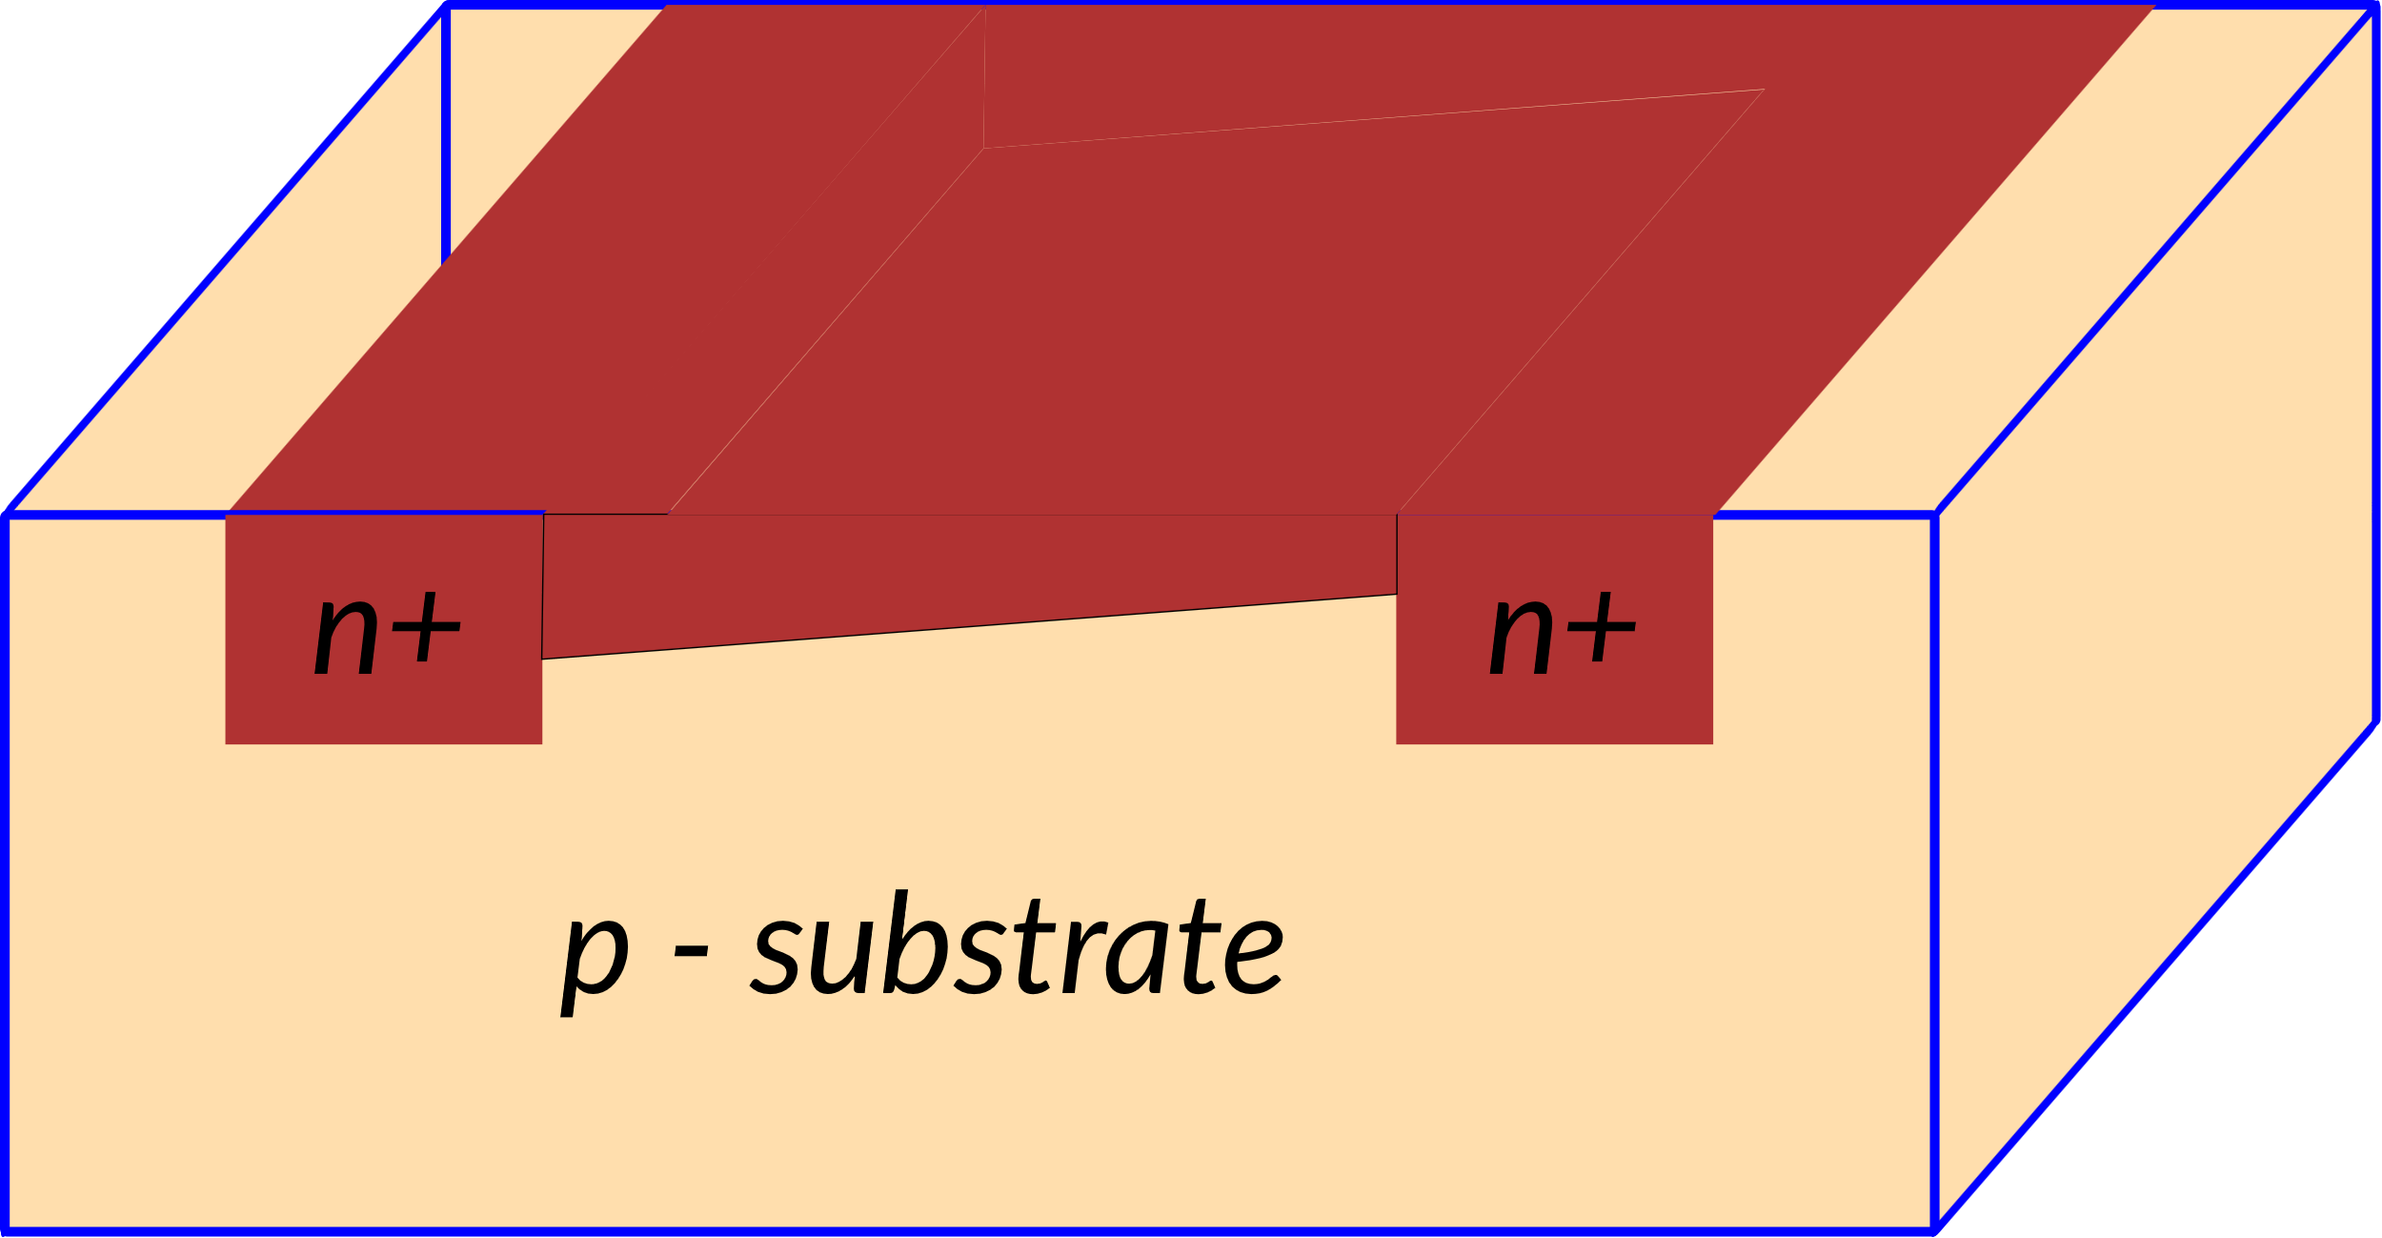
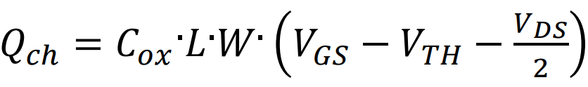
Derivation of I-V Characteristics
3. Drain Current at the linear, or triode, region. (As VDS is increased, the charge channel narrows at the drain end)
VDS modifies the voltage, and, the charge along the channel.
The voltage component due to VDS is maximum at the drain end, while it is zero at the Source end.
Suppose a linear distribution of the voltage component due to VDS along the channel, its average value can be approximately estimated to be VDS/2.
Then, a more accurate calculation of the channel charge can be obtained by adding VDS/2 in the charge expression
(C)
A more accurate calculation of the IDS current in linear region is also possible:
Drain Current at the linear, or triode, region.
(D)

Slide 14
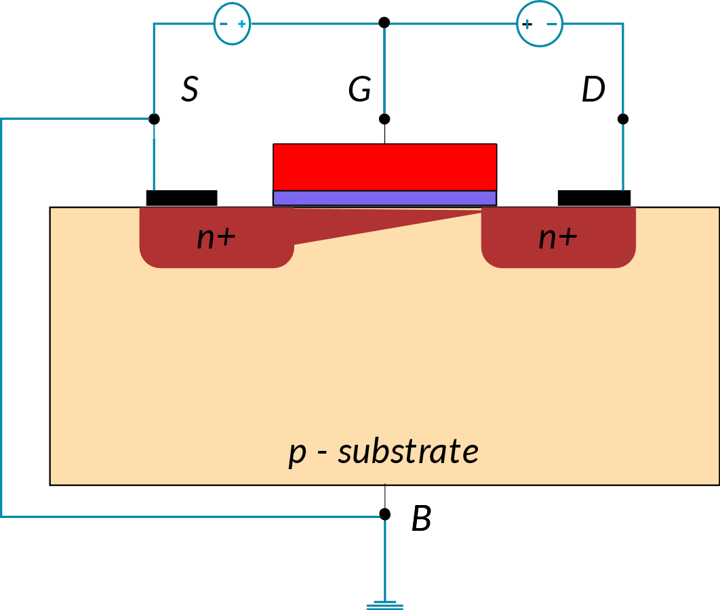
Derivation of I-V Characteristics
4. Drain Current at Saturation Region (As VDS approaches VGS‐VTH, )
As VDS approaches VGS ‐ VTH, the channel charge approaches zero at the Drain end.
When VDS compensates for the overdrive voltage VGS‐VTH, VGD results to be equal to the threshold voltage VTH
(E)
In this bias condition, no channel charge is available at the Drain end. The conducting channel pinches‐ off, disconnecting the Drain.
The VDS value that produces the channel pinch‐off is called saturation voltage (VDS,sat).
Substituting the VDS value in equation A, the expression of the IDS at the pinch‐off is obtained:
(F)
Therefore, when VDS increases, this depletion region enlarges, and the pinch‐off point moves toward the Source.
For your reference, Eq. A

Slide 15
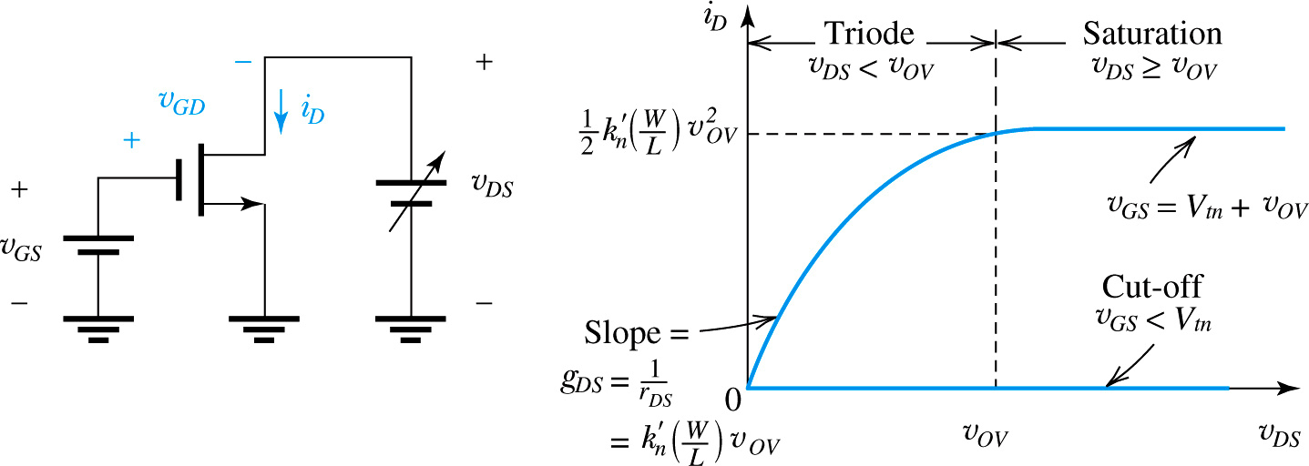






Non-linear effect and Current-voltage characteristics
The characteristics can be measured at dc or at low frequencies and thus are called static characteristics.
The dynamic effects that limit the operation of the MOSFET at high frequencies and high switching speeds.
where k’_{n} , g_{DS} , and r_{DS} are process transconductance parameter, channel conductance, and linear resistance, respectively.

Slide 16
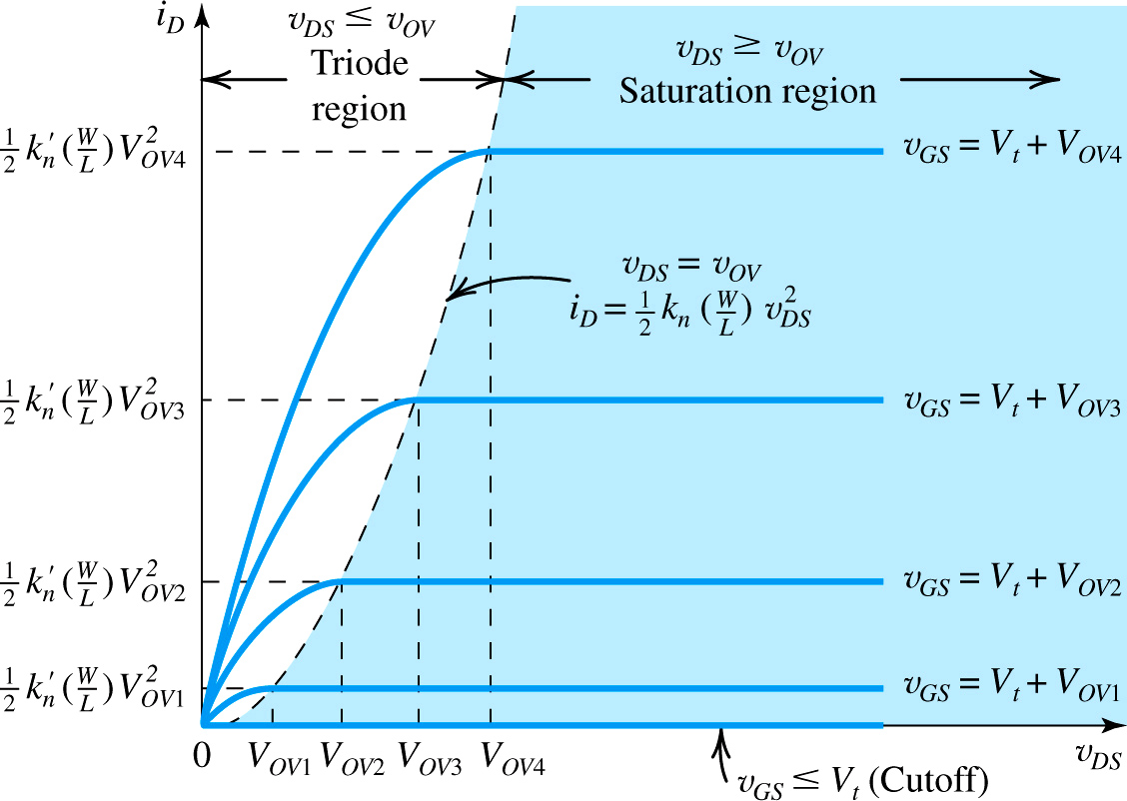









DC characteristics of MOSFET
Fig. 13 The drain current versus the drain-to source voltage for an enhancement type NMOS transistor.

Slide 17
Second Order Effects:
Following are the list of second order effects of MOSFET.
Channel length modulation
Velocity Saturation
Mobility Degradation
Threshold voltage – Body effect
Subthreshold region
Drain Punchthrough
Impact Ionization – Hot Electrons

Slide 18
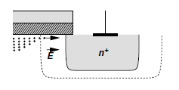
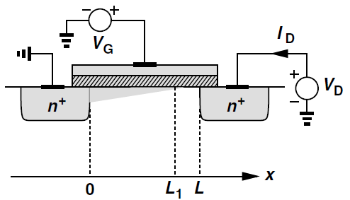

Channel Length Modulation
The length of the channel changes with changing values of VDS.
As the value of VDS is increased, it causes the depletion region of the Drain junction to grow.
This reduces the length of the channel which impacts current. The model current equation must be modified to
In general, lambda is proportional to channel length.
The effects of channel length modulation become more pronounced for smaller feature sizes.
Thus, when a high impedance current source is required, longer channel transistors are used.

Slide 19
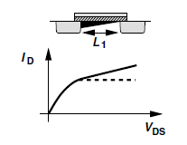
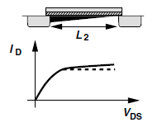
Channel Length Modulation
This phenomenon yields a larger drain current as V_{DS} increases because I_{D} ∝ 1/L₁

Slide 20
Velocity Saturation
Carrier velocity increases with increasing electric fields.
V= μE
At high electric fields (V_{DS}), carrier mobility degrades, eventually leading to a constant velocity.
However, once the critical lateral electric field is reached, the velocity of the carriers does not increase any further.
This is caused by an increased rate of collision and carrier scattering.
The current does not increase at the expected rate. Rather, the current increases very little.
Owing to their very short channels (e.g., 0.1 μm), modern MOS devices experience velocity saturation even with drain-source voltages as low as 1 V.

Slide 21
Mobility Degradation
With increasing VGS, vertical electric fields increase.
This increase causes a rise in the number of carrier collisions, which degrades carrier mobility.
The current flowing through the transistor is expected by the ideal models.
Mobility decreases with increasing temperature.

Slide 22
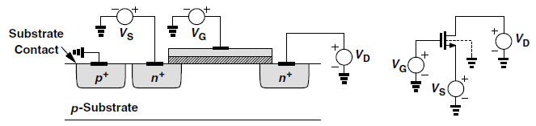
Body Effect
In MOSFETs, we have assumed that both the source and the substrate (also called the “bulk” or the “body”) are tied to ground.
However, this condition need not hold in all circuits.
If the source terminal rises to a positive voltage while the substrate is at zero, then the source-substrate junction remains reverse-biased and the device still operates properly.
An interesting phenomenon occurs as the source-substrate potential difference departs from zero:
The threshold voltage of the device changes.
In particular, as the source becomes more positive with respect to the substrate, V_{TH} increases. Called “body effect,”

Slide 23
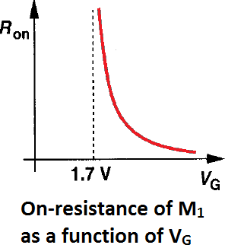
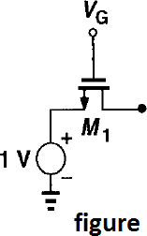
SESSION DESCRIPTION
Example: For the arrangement in figure. Plot the on-resistance of M₁ as a function of V_{G}.
Assume μ_{n}C_{ox} = 50 μA/V², W/L = 10 and V_{TH} = 0.7 V. Note that the drain terminal is open.
Solution: As drain terminal is open, I_{D} = 0 and V_{DS} = 0 Thus if device is ON, it operates in deep triode region. For (V_{GS} – V_{TH}) < 0, M₁ is OFF, R_{on} = ∞
For (V_{GS} – V_{TH}) > 0, M₁ is ON and R_{on} is given by
R =
1
on
50μA/V² ×10( Vg − 1V − 0.7V)

Slide 24
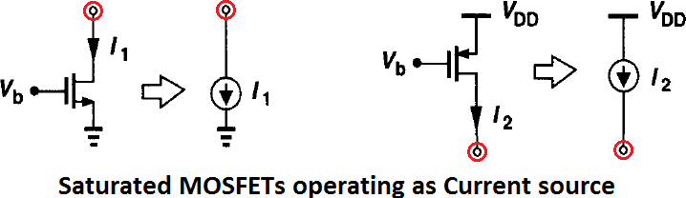
SESSION DESCRIPTION
Note:
For approximation L ≈ L’, a saturated MOSFET can be used as a current source connected between the drain and the source (an important component in analog design).
Note that the current sources inject current into ground or draw current from V_{DD}. In other words, only one terminal of each current source is “floating” .
Transconductance ‘g_{m}’
Change in the drain current divided by the change in the gate-source voltage called the “transconductance” and denoted by g .
g
₌ ∂I_{D}
= μ C ^{W} (V − V )
m
∂V
n ox GS
TH
GS
L
V_{DS} const.

Slide 25
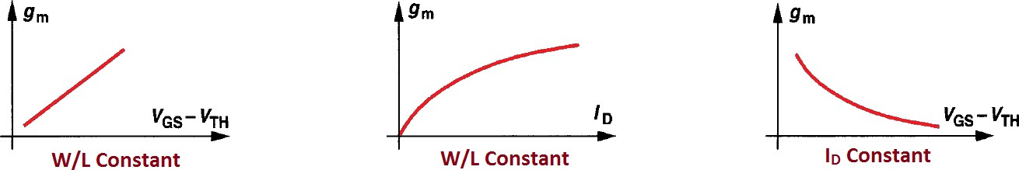
What is the significance of transconductance in MOSFET or Why we need to calculate transconductance in MOSFET ?
A MOSFET operating in saturation produces a current in response to its gate- source overdrive voltage.
That’s why, we define a figure of merit that indicates how well a device converts a voltage to a current.
Therefore we define the figure of merit as the change in the drain current divided by the change in the gate-source voltage called the “transconductance”
g
₌ ∂I_{D}
= μ C ^{W} (V − V )
m
n ox GS
TH
∂V
GS
L
V_{DS} const.
In a sense, g_{m} represents the sensitivity of the device:
For a high g_{m}, a small change in V_{GS} results in a large change in I_{D}.
Interestingly, g_{m} in saturation region is equal to the inverse of R_{on} in deep triode region.
g_{m} can also be expressed as
W
W
2I
g_{m} = μ_{n}C_{ox} (V_{GS} − V_{TH} )
g = 2μ C
I
g
₌ D
L
m n ox D
m
L
V − V
GS TH

Slide 26
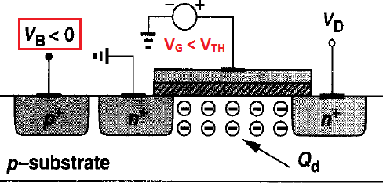
SESSION DESCRIPTION
Case2) : V_{s} = 0 but V_{B} < 0 (become negative), more holes attract to substrate connection, leaving a larger negative charge behind, i.e. depletion region becomes wider.
Therefore Q_{d} increases when V_{B} becomes more negative than V_{S} in NMOS transistor.
reg
As V_{TH} = φ_{MS} + 2φ_{F}
^{Q}dep
Threshold voltage is a function of Q_{d} because gate charge must mirror Q_{d} before an inversion layer is formed
C
ox
Thus V_{B}↓ → Q_{d}↑ → V_{TH}↑ → “Body Effect” or “Backgate Effect”
V_{TH} including Body Effect can be proved as
γ( 2φ_{F} + V_{SB} − 2φ_{F} )
^{V}TH ^{= V}TH0
[where V_{SB} is source-bulk potential
^{Q}dep ^{2q∈}si ^{N}sub
^{V}TH0
= φ_{MS} + 2φ_{F} +
, γ = denotesBody effect coefficient
^{C}ox ^{C}ox

Slide 27
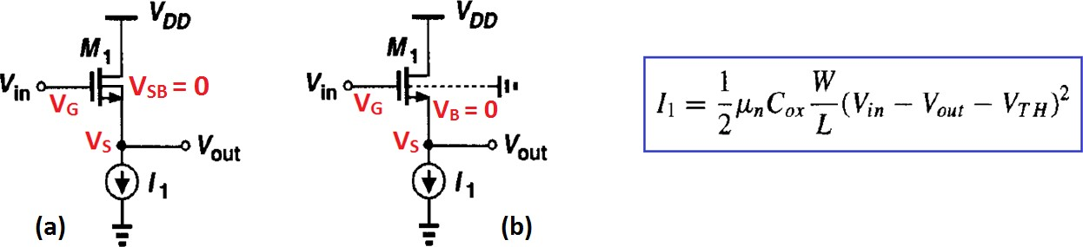
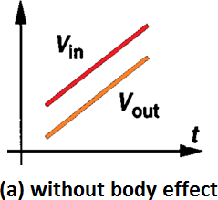
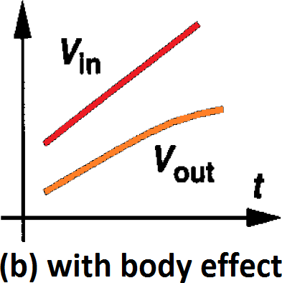
SESSION DESCRIPTION
Note: Body effect can also be seen when V_{sub} is not changing while V_{source} is changing
w.r.t V_{sub} → Same phenomenon occurs
For Ex: Considering this circuit we will plot V_{in} and V_{out} w.r.t. time to see Body effect.
Fig. a) Without considering Body effect i.e. No effect of V_{SB} on V_{TH}.
As V_{in} varies with time, V_{out} closely follows V_{in} because drain current remains equal to I₁.
Concluding V_{in} – V_{out} is constant if I₁ is constant.
Fig. b) Considering Body effect i.e. V_{SB} ≠ 0 and will effect V_{TH}.
As V_{in}↑ with time → V_{out}↑ too → V_{SB} also ↑ which increases V_{TH}. To maintain I₁ constant, V_{in} – V_{out} must increases as shown in graph.
Body effect is undesirable and complicates the analog design.

Slide 28
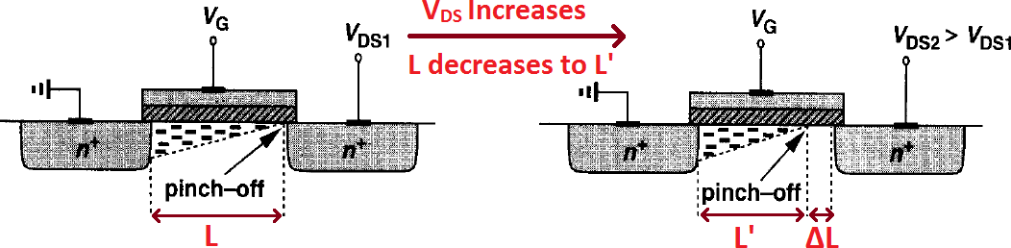
Channel-Length Modulation
Actual length (L’) of inverted channel gradually decreases as V_{DS} increases.
In other words, L’ is a function of V_{DS}.
Current and Voltage relation including Channel-Length modulation
In previous I-V equation → replace L by L’
i .e. I = ¹ μ C ^{W} (V − V
₎2
D n ox
L′
GS TH
2
∆L = L – L’ → L’ = L – ∆L (where L >> ∆L)
Therefore ¹ ≈ ⎛1 + ^{ΔL ⎞}/L (taking only firs t- order)
⎜ ⎟
L'
⎝
L ⎠

Slide 29
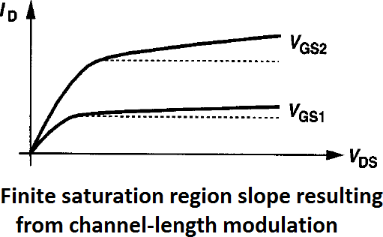
As L’ is a function of V_{DS} → Assuming a first-order relationship b/w ∆L/L and V_{DS} i.e.
∆L/L = λV_{DS} → Putting this relation in previous equation and then in I-V eqn
I ≈ ¹ μ C ^{W} (V − V
)² (1+ λV )
D n ox
GS TH
DS
2 L
λ = Channel-length modulation coefficient
Parameter λ represents the relative variation in length for a given increment in V_{DS}.
Effect of channel-length modulation cause a non-zero slope in I_{D}/V_{DS} (shown in graph).
This cause non-ideal current source b/w D and S in saturation.
Thus for longer channel → λ is small → I_{D} depend less on V_{DS} in saturation.
g_{m} considering channel-length modulation
g = μ C ^{W} (V − V )(1+ λV ) =
2μ_{n}C_{ox}(W/L)I_{D}
m n ox
GS TH DS
L 1 + λV
DS
Linear approximation ∆L/L 𝖺 V_{DS} becomes less accurate in short-channel transistors, resulting in a variable slope

Slide 30
ACTIVITIES/ CASE STUDIES/ IMPORTANT FACTS RELATED TO THE SESSION
Activities:
Given a n-MOSFET with a threshold voltage of 3V, a gate-source voltage of 4V, a drain-source voltage of 8V, and a drain current of 2mA, determine the operating region of the MOSFET. Assume the value of Kp as 100uA/V^2 and calculate the W/L ratio of the n-MOSFET

Slide 31
ACTIVITIES/ CASE STUDIES/ IMPORTANT FACTS RELATED TO THE SESSION
Activities:
Given a n-MOSFET with a threshold voltage of 3V, a gate-source voltage of 4V, a drain-source voltage of 8V, and a drain current of 2mA, determine the operating region of the MOSFET. Assume the value of Kp as 100mA/V^2 and calculate the W/L ratio of the n-MOSFET
SOL: Vgs - Vth = 4V - 3V = 1V, which is less than Vds = 8V.
AS Vgs > Vth and Vds > Vgs - Vth, the MOSFET is in the saturation region, and the drain current can be calculated using the equation
Id = (W/2L)Kp(Vgs - Vth)^2, where W is the channel width, L is the channel length, and Kp is the MOSFET's transconductance.
Then, 2mA = (W/2L)100uA/V^2(1V)^2
W/L = 4:1

Slide 32
SUMMARY
1. MOSFET stands for Metal Oxide Semiconductor Field Effect Transistor. It is a type of transistor that uses a voltage signal applied to the gate to control the flow of current through the device.
2. There are two types of MOSFETs: n-channel and p-channel. In an n-channel MOSFET, the majority carriers are electrons, and in a p-channel MOSFET, the majority carriers are holes.
3. The operating regions of a MOSFET are the cut-off, triode (or linear), and saturation regions. The MOSFET operates in the cut-off region when the gate-source voltage is less than the threshold voltage, in the triode region when the gate-source voltage is greater than the threshold voltage but the drain-source voltage is less than the gate-source voltage minus the threshold voltage, and in the saturation region when the gate-source voltage is greater than the threshold voltage and the drain-source voltage is greater than or equal to the gate-source voltage minus the threshold voltage.

Slide 33
SUMMARY
4. The VI (voltage-current) characteristics of a MOSFET are typically shown on a graph with the drain-source voltage (Vds) on the x-axis and the drain current (Id) on the y-axis. The VI characteristics for a MOSFET in the triode region are linear, while in the saturation region, they are nearly constant. In the cut-off region, the MOSFET exhibits no current flow.
5. To properly bias a MOSFET, it's important to choose the appropriate voltage levels for the gate-source voltage and drain-source voltage, depending on the desired operating region of the MOSFET. Additionally, the MOSFET's transconductance parameter (Kp) should be considered when calculating the device's drain current, and factors such as temperature and noise may also affect the device's performance.

Slide 34
SELF-ASSESSMENT QUESTIONS
1. Why is Inverter considered as the nucleus of all digital designs? 1. When the drain voltage in an n-MOSFET is negative, it is operating in
a. active region
b. inactive region
c. ohmic region
d. reactive region
2. What is the main difference between MOSFETs and BJTs in terms of their I-V characteristics?
a. current is quadratic with VGS for MOSFETs and linear with VBE for BJTs
b. current is linear with VGS for MOSFETs and exponential with VBE for BJTs
c. current is exponential with VGS/VBE in both these devices, but rise is faster in MOSFETs
d. current is quadratic with VGS for MOSFETs and exponential with VBE for BJTs
3. The MOSFET switch in its on-state may be considered equivalent to
a. capacitor
b. inductor
c. battery
d. resistor

Slide 35
TERMINAL QUESTIONS
1. Discuss the different operating regions of a MOSFET
2. With a neat sketch describe the V-I characteristics of E-MOSFET

Slide 36
REFERENCES FOR FURTHER LEARNING OF THE SESSION
Text Books:
1) BehzadRazavi, “Design of Analog CMOS Integrated Circuits”, Tata Mc Graw Hill, (2005)
2) Jacob Baker, “CMOS Mixed Signal Circuit Design”, John Wiley, (2008)
Reference Books:
1) Neil H. E. Weste and David. Harris Ayan Banerjee, “CMOS VLSI Design” – Pearson Education, 1999.
2) Gray& Mayer, “Analysis & Design of Analog Integrated Circuits”, 4th edition, Wiley, (2001).17. Keywords
Sites and Web links:
1. https://www.egr.msu.edu/classes/ece410/mason/files/Ch7.pdf
2. http://bwrcs.eecs.berkeley.edu/Classes/icdesign/ee141_f01/Notes/chapter5.pdf
3. https://nptelvideos.com/video.php?id=1317

Slide 37

THANK YOU
Team – Analog VLSI Design

